Slide 1
9.4 Forward Measure

Slide 2
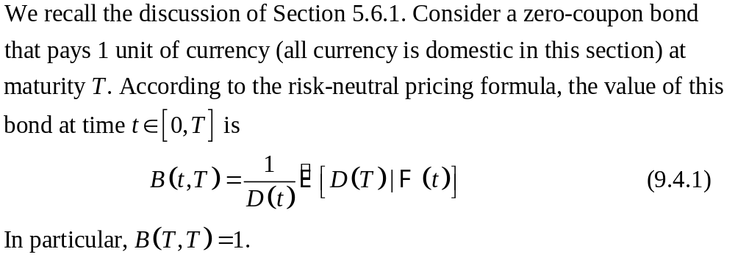
9.4.1 Forward Price

Slide 3
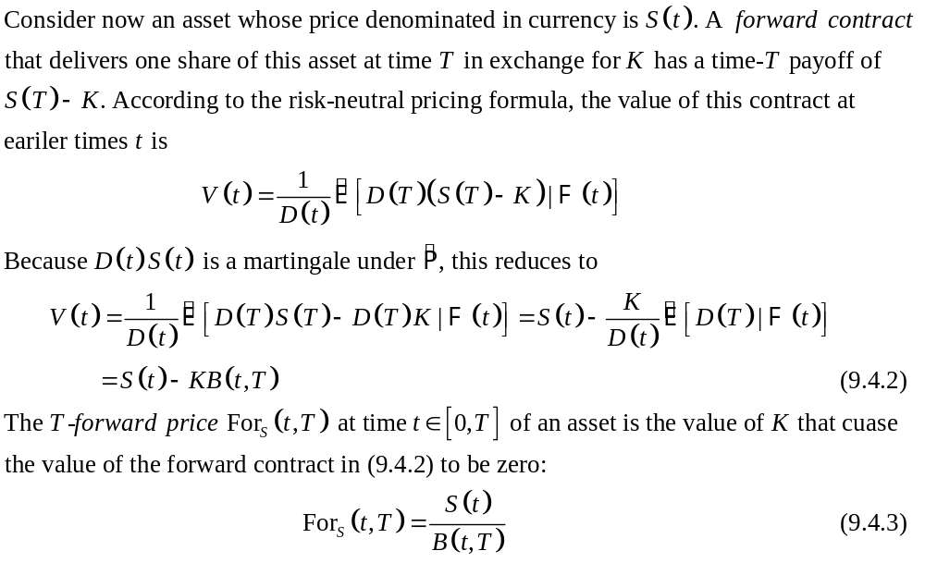

Slide 4
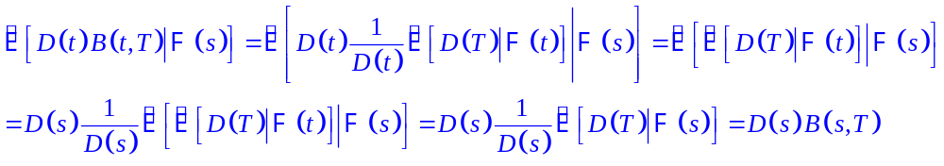
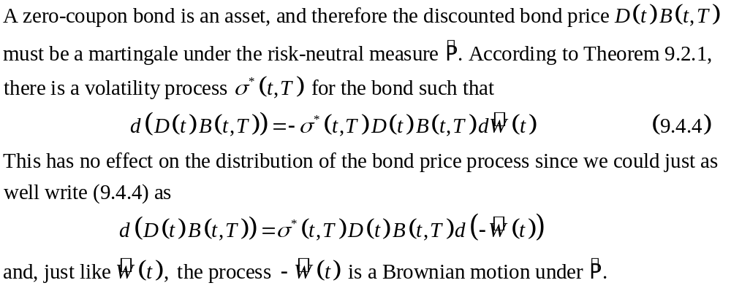
9.4.2 Zero-Coupon Bond as Numeraire
Theorem 9.2.1

Slide 5
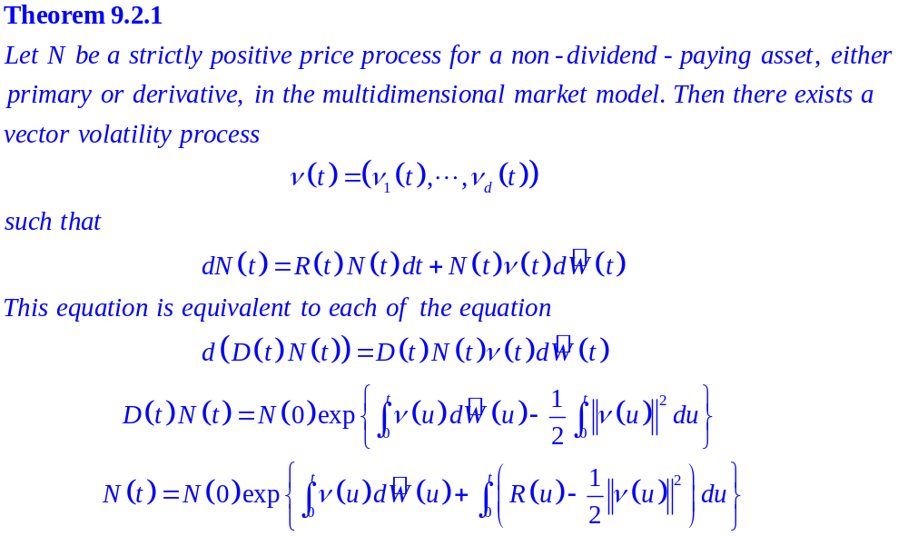

Slide 6
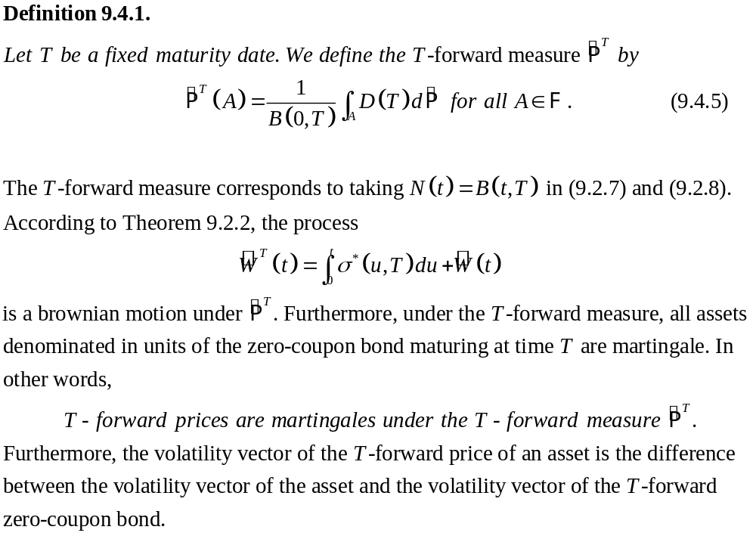
Theorem 9.2.2

Slide 7
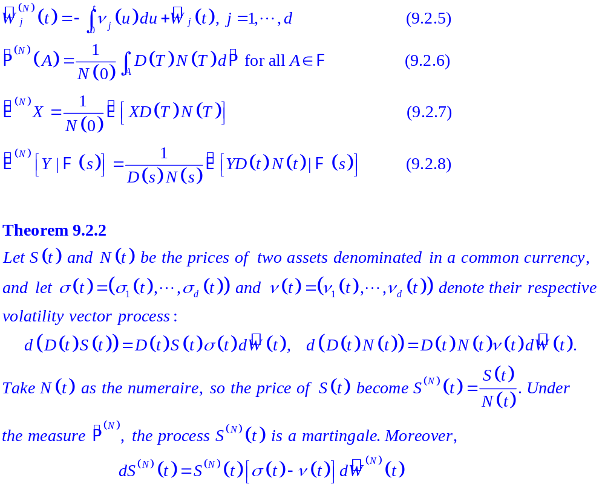

Slide 8
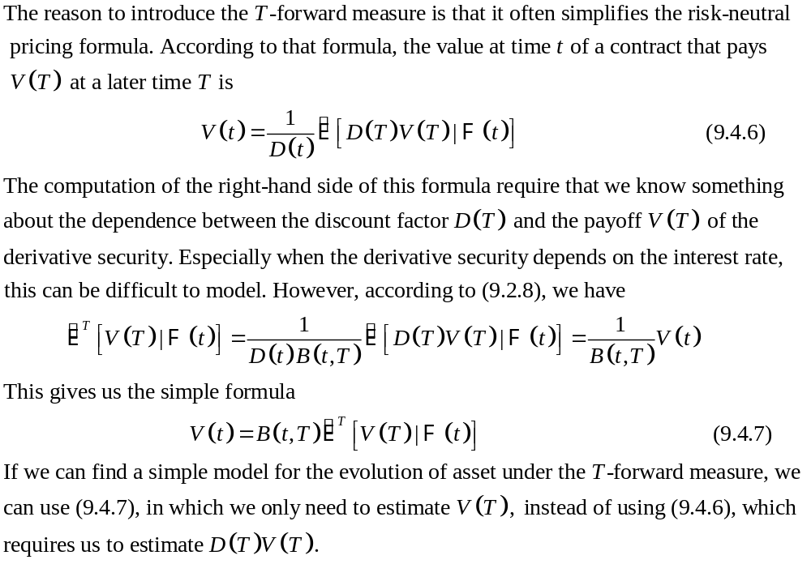

Slide 9

9.4.3 Option Pricing with a Random Interest Rate
The classical Black-Scholes-Merton formula assumes a constant interest rate.
In this section, we present a generalized Black-Scholes-Merton formula that permits the interest rate to be random.
the volatility of the underlying asset (constant)
→ the volatility of the forward price (constant)
Because the forward price is a martingale under the forward measure, and is the Brownian motion used to drive asset prices under the forward measure, the assumption of constant volatility for the forward price is equivalent to the assumption

Slide 10
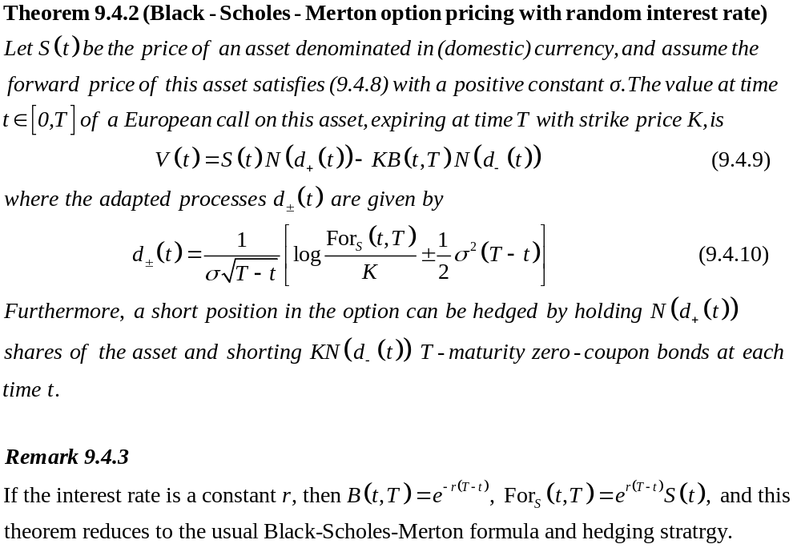

Slide 11
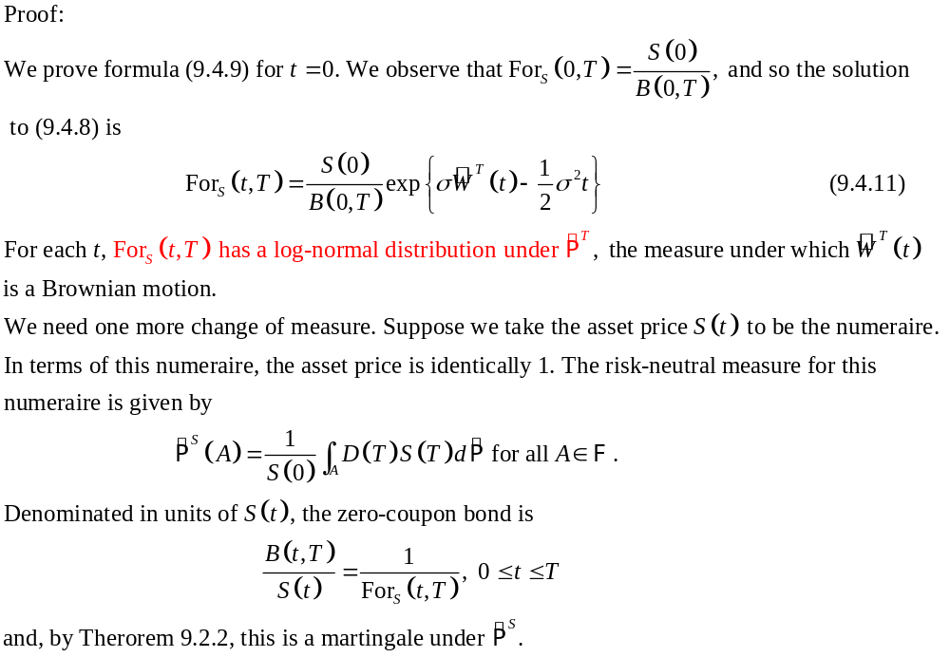
Theorem 9.2.2

Slide 12
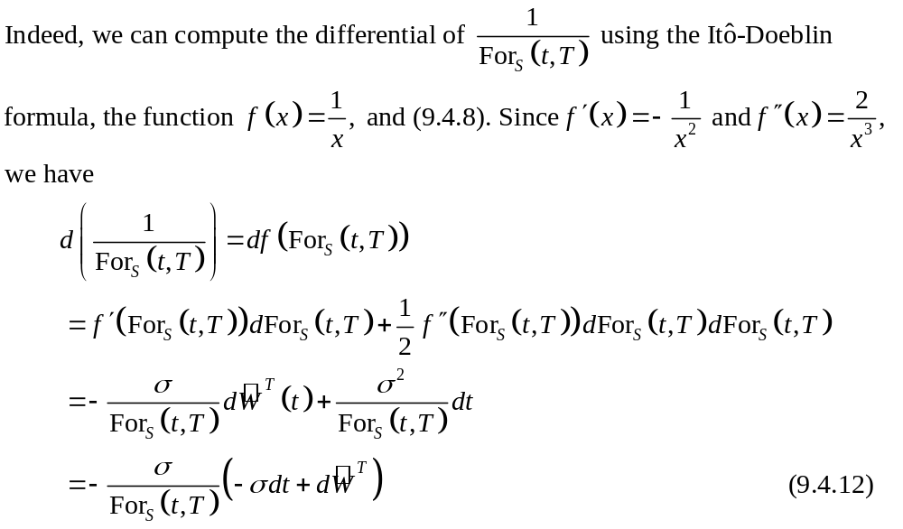

Slide 13
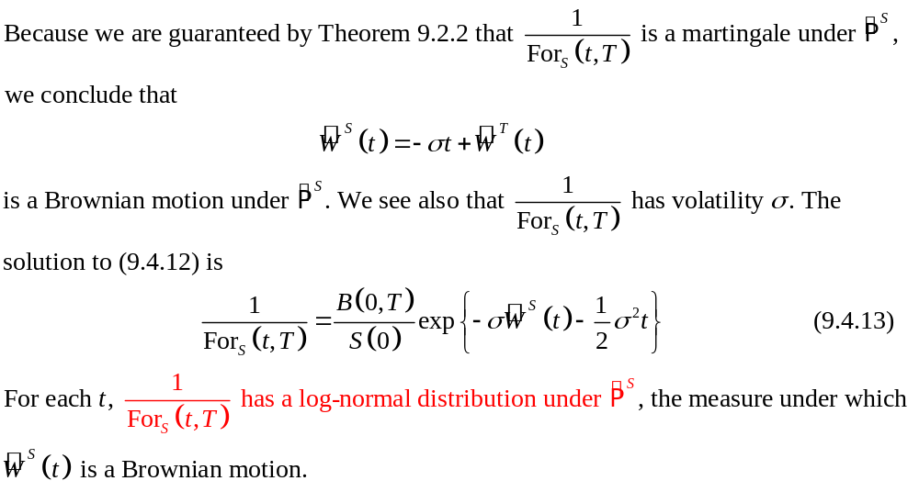

Slide 14
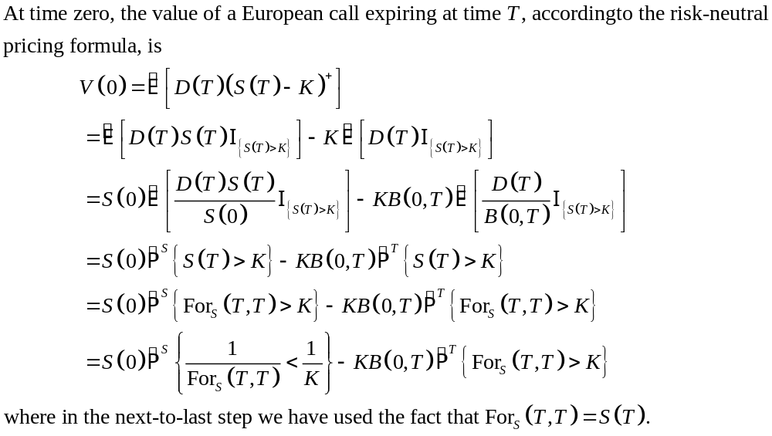
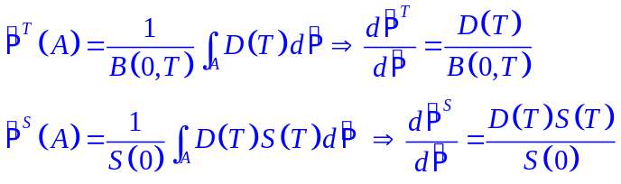

Slide 15
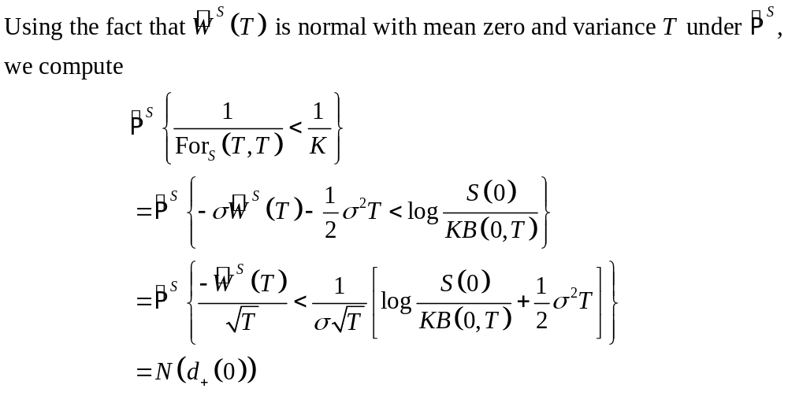
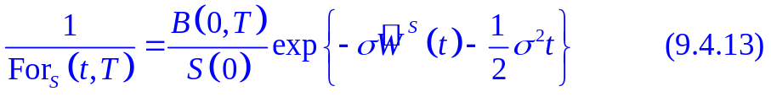

Slide 16
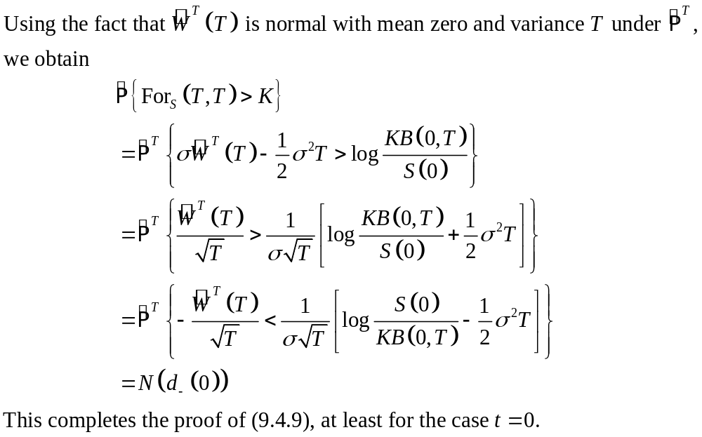
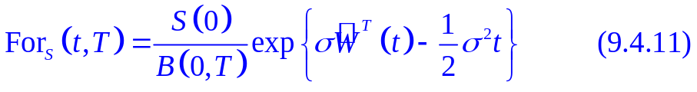

Slide 17
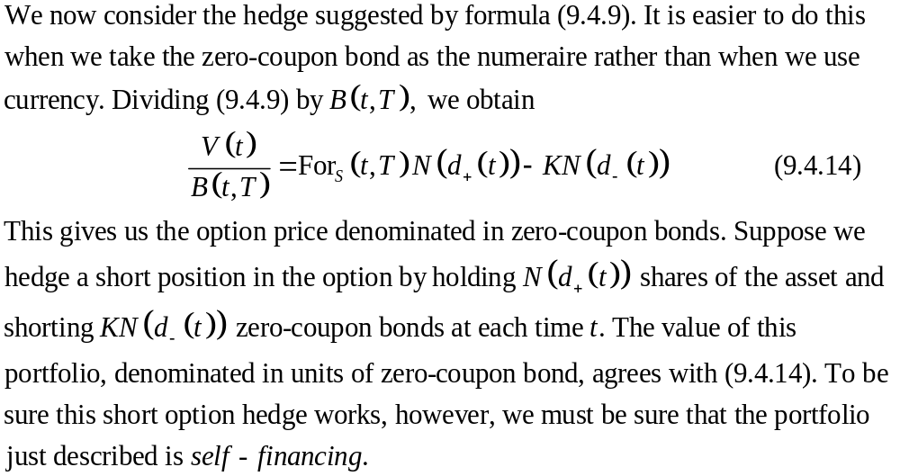

Slide 18
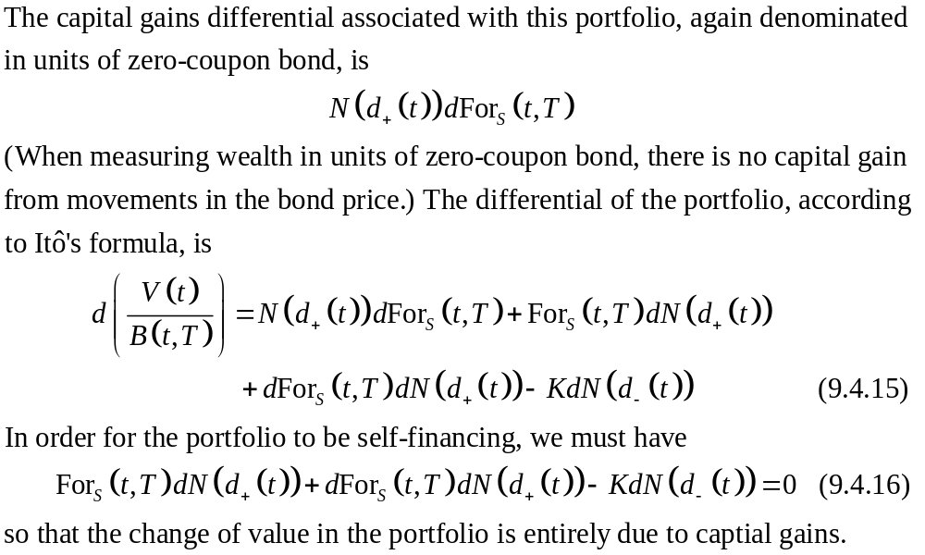

Slide 19
